Slide 1

Interactive inspection of complex multi-object industrial assemblies
O. Argudo, I. Besora, P. Brunet ∗, C. Creus, P. Hermosilla, I. Navazo, À. Vinacua ViRVIG Research Group, Technical University of Catalonia, Spain Reportor: Yanli Shao
2016.12.16

Slide 2
Outline
1. Introduction
2. Previous work
3. View-dependent, front-based rendering
4. Hybrid multiresolution trees (HMTs)
5. Visualization and interactive scene editing
6. Results & Conclusions and future work

Slide 3
Introduction
The use of virtual prototypes and digital models containing thousands of individual objects is commonplace in complex industrial applications. Designers are interested in selecting and editing specific sets of objects during the interactive inspection sessions.
Requirements for inspection of complex multi-object assemblies:
The View-Dependent Visualization algorithm should guarantee a certain frame-rate with good image quality.
The System must support the selection of individual objects and of hierarchies of objects, during the navigation, to access information of these objects or to annotate and modify them.
Limited scene editing (including displacement of the selected objects) and real-time collision detection during scene editing must be supported.
No present algorithm fulfill all of the above requirements.
Notes:
以前方法大部分采用替换、修改和简化几何的方式来模糊场景结构和对象个体，但是我们希望保留设计意图，以及原始CAD模型的设计树结构，这些对用户非常有意义。

Slide 4
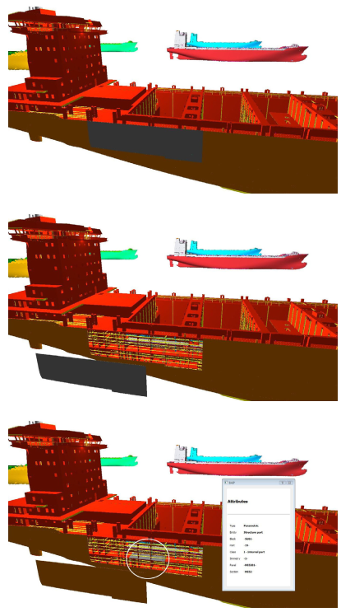
Introduction
A solution that preserves CAD hierarchies and object identities while allowing simple interactions: mmc1.mp4
A formal discussion of the front concept in multiresolution trees, and the characterization of the properties required for time-critical rendering.
An object-aware scene simplification and multiresolution scheme that results in a multilayered, multiresolution tree with cost and benefit functions per node, which is monotonic by construction.
Support for the selection of individual objects and sets of objects, displacement of the selected objects and real-time collision detection while in the interactive navigation.
A time-critical, view-dependent visualization algorithm with constrained front update based on a greedy optimization per frame.
Notes:
对于大型模型，本文方法能够在保证帧率的情况下满足上述要求， 在保留CAD层次结构和对象身份同时允许简单交互的解决方案，本文贡献如下：

Slide 5
Outline
1. Introduction
2. Previous work
3. View-dependent, front-based rendering
4. Hybrid multiresolution trees (HMTs)
5. Visualization and interactive scene editing
6. Results & Conclusions and future work

Slide 6
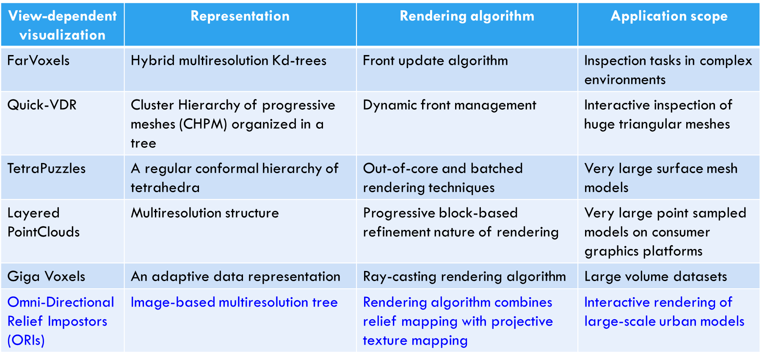
Previous work
Multiresolution Trees are well known data structures that represent scenes and assemblies at multiple resolutions.
Binary, quaternary or octal, and based on either a spatial subdivision or a scene subdivision.
View-dependent visualization algorithms.
Notes:
这里仅讨论一些与本文算法最相关的工作，比如场景模型在不同细节层次的场景数据结构的表示，以及交互可视化过程中，每帧中次优节点的计算和渲染 。
视图相关可视化算法是基于对象层次结构（多分辨率树）以及动态渲染前段来自适应可视化。ORIs基于图像的多分辨率树表示，在树中的每一层中采用具有可信替身的节点来表示多分辨率城市场景。渲染算法组合可信映射和投影纹理映射，使用部分预计算的可信替身，
本文方法和ORIs方法相关，在RI-layer采用ORIs技术，但是在优化框架中，除了benefit function还考虑了cost function来提高性能.

Slide 7
Impostor技术
定义：在预计算阶段把某些指定对象经投影变换转换成带有透明信息的纹理图像，映射到四边形平面后，再放置到场景中该对象原来所在的位置，并将这些对象成为图像替身。
分类：
静态Impostor：提前创建，可改进帧速，但随着场景数量的增加，所需纹理占用的内存空间太大。
动态Impostor：在参考视点移动过程中动态创建，在绘制过程中，Impostor平面替代原有的场景。不但可以提供相同的外观特性，还可加速绘制。绘制Impostor平面时间依赖于屏幕中显示的Impostor平面的分辨率大小，而与原有场景部分的几何复杂度无关，从而便于快速显示任意场景。
Impostor技术优点：
快速绘制场景，绘制impostor平面的时间远小于绘制大堆多边形的时间；
绘制静态的远处场景非常有效；
绘制不同层次细节条件下的同类场景非常有效；
与简化模型相比，impostor平面不以牺牲细节为代价，能够克服低精度的层次细节(LOD)限制；
帧连续的时候可以重复使用前面帧所产生的相同光栅化图像；
图像纹理精度仅仅取决于最后屏幕上所形成impostor平面的分辨率大小，因此用来存储纹理所占用内存空间消耗不大。
Impostor技术缺点：在参考视点移动过程中，需要根据误差来确定是否动态更新impostor平面的内容。

Slide 8
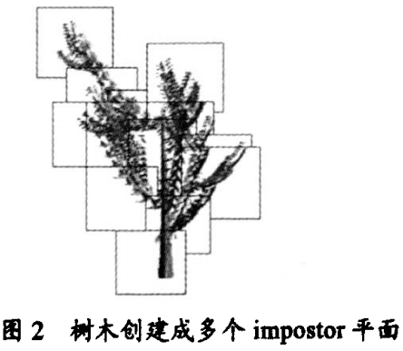
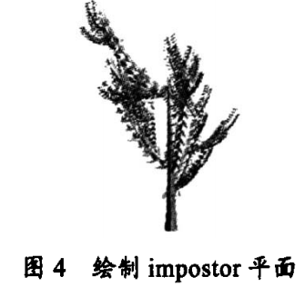
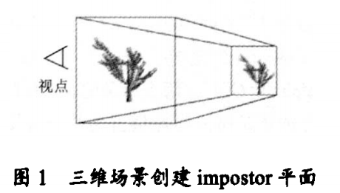
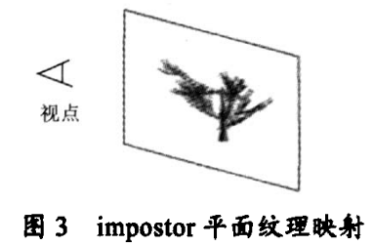
Impostor技术
创建Impostor平面：通过三维场景的包围盒得到，这个包围盒可以限定场景的范围。当参考视点确定以后，包围盒将三维场景投影到对应的平面空间上，这个平面空间装入了三维包围盒的所有投影顶点，在平面空间上就形成了impostor平面。
绘制Impostor平面：
描绘Impostor平面->视觉依赖的纹理映射操作。将投影时候所确定的纹理图像映射到每一个相应的Impostor平面上。
绘制Impostor平面->根据Impostor平面深度、位置信息确定Impostor纹理平面的先后顺序。

Slide 9
Previous work - View-dependent visualization algorithms
View-dependent visualization | Representation | Rendering algorithm | Application scope
FarVoxels | Hybrid multiresolution Kd-trees | Front update algorithm | Inspection tasks in complex environments
Quick-VDR | Cluster Hierarchy of progressive meshes (CHPM) organized in a tree | Dynamic front management | Interactive inspection of huge triangular meshes
TetraPuzzles | A regular conformal hierarchy of tetrahedra | Out-of-core and batched rendering techniques | Very large surface mesh models
Layered PointClouds | Multiresolution structure | Progressive block-based refinement nature of rendering | Very large point sampled models on consumer graphics platforms
Giga Voxels | An adaptive data representation | Ray-casting rendering algorithm | Large volume datasets
Omni-Directional Relief Impostors (ORIs) | Image-based multiresolution tree | Rendering algorithm combines relief mapping with projective texture mapping | Interactive rendering of large-scale urban models

Slide 10
Previous work
Funkhouser TA, Sequin CH. Adaptive display algorithm for interactive frame rates during visualisation of complex virtual environments. In: Proceedings of SIGGRAPH’93, 1993, pp. 247–254. scenes of only moderate complexity.
Previous defects:
They cannot distinguish the different objects that make up the scene. Funkhouser’s paper contained some key ideas that have not been used, nor adapted to scene trees.
The front update is based on a suitable benefit function, but does not consider information about the frame computing and rendering.
They do not consider view-dependent rendering as a constrained problem with an upper bound in rendering cost.
Notes:
Funkhouser方法具有开创性，适用于中等复杂程度的场景。HMT表示 标准简化算法 cost benefit greedy front update algorithm.
以前方法缺陷在于不能区分组成场景的不同对象。以前算法中，前端更新主要基于合适的benefit function，没有考虑帧计算和渲染时间。

Slide 11
Outline
1. Introduction
2. Previous work
3. View-dependent, front-based rendering
4. Hybrid multiresolution trees (HMTs)
5. Visualization and interactive scene editing
6. Results & Conclusions and future work

Slide 12
View-dependent, front-based rendering
Multiresolution geometric models supporting view-dependent rendering must encode the steps performed by a simplification or coarsening process in a compact data structure from which a virtually continuous set of variable-resolution models can be efficiently extracted.
A Multiresolution Tree is a hierarchical scene representation which encodes parts of the scene at a full range of different resolutions. They can encode scenes with multiple objects or highly complex meshes.
Notes:
介绍基于多分辨率树表示的渲染前端算法一些属性。
支持视图相关渲染的多分辨率几何模型必须对紧凑数据结构中的简化或粗化过程执行的步骤进行编码，从中可以有效地提取虚拟连续的可变分辨率模型集

Slide 13
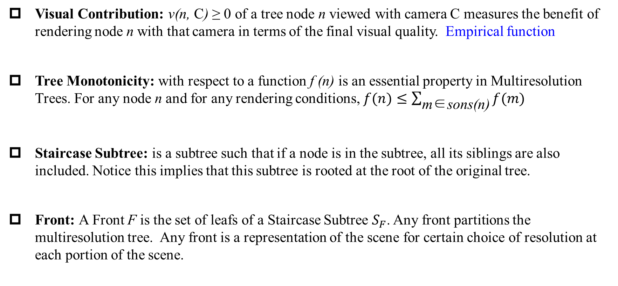
Concepts in Multiresolution Tree
Visual Contribution: v(n, C) ≥ 0 of a tree node n viewed with camera C measures the benefit of rendering node n with that camera in terms of the final visual quality. Empirical function
Tree Monotonicity: with respect to a function f (n) is an essential property in Multiresolution Trees. For any node n and for any rendering conditions, $f(n)≤\sum_{\text{m}\text{∈}\text{sons}\text{(}\text{n}\text{)}}{f(m)}$
Staircase Subtree: is a subtree such that if a node is in the subtree, all its siblings are also included. Notice this implies that this subtree is rooted at the root of the original tree.
Front: A Front F is the set of leafs of a Staircase Subtree $S_{F}$. Any front partitions the multiresolution tree. Any front is a representation of the scene for certain choice of resolution at each portion of the scene.
Notes:
视觉贡献一般定义为与节点n中几何信息以及视图相关的参数来确定的经验函数。
任何前端分割多分辨率树，任何前端都是场景不同部分不同分辨率的一种表示。

Slide 14
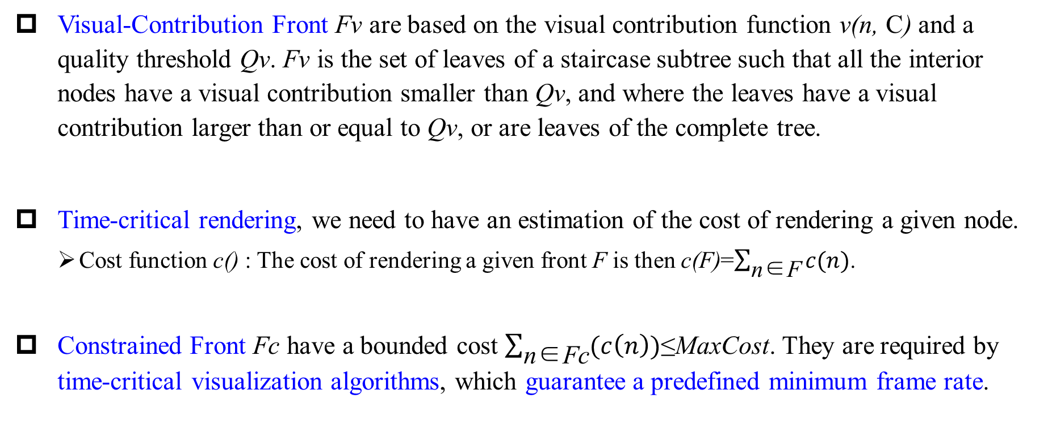
Fronts
Visual-Contribution Front Fv are based on the visual contribution function v(n, C) and a quality threshold Qv. Fv is the set of leaves of a staircase subtree such that all the interior nodes have a visual contribution smaller than Qv, and where the leaves have a visual contribution larger than or equal to Qv, or are leaves of the complete tree.
Time-critical rendering, we need to have an estimation of the cost of rendering a given node.
Cost function c() : The cost of rendering a given front F is then c(F)=$\sum_{\text{n}\text{∈}\text{F}}{c(n)}$.
Constrained Front Fc have a bounded cost $\sum_{\text{n}\text{∈}\text{Fc}}{(c\left(n\right))\text{≤}\text{MaxCost}}$. They are required by time-critical visualization algorithms, which guarantee a predefined minimum frame rate.
Notes:
Fc 在每一帧中，新前端一般是在CPU中计算，并送到GPU中进行渲染，但是避免传递已经在GPU中的信息，一般不考虑帧渲染时间。

Slide 15
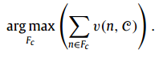
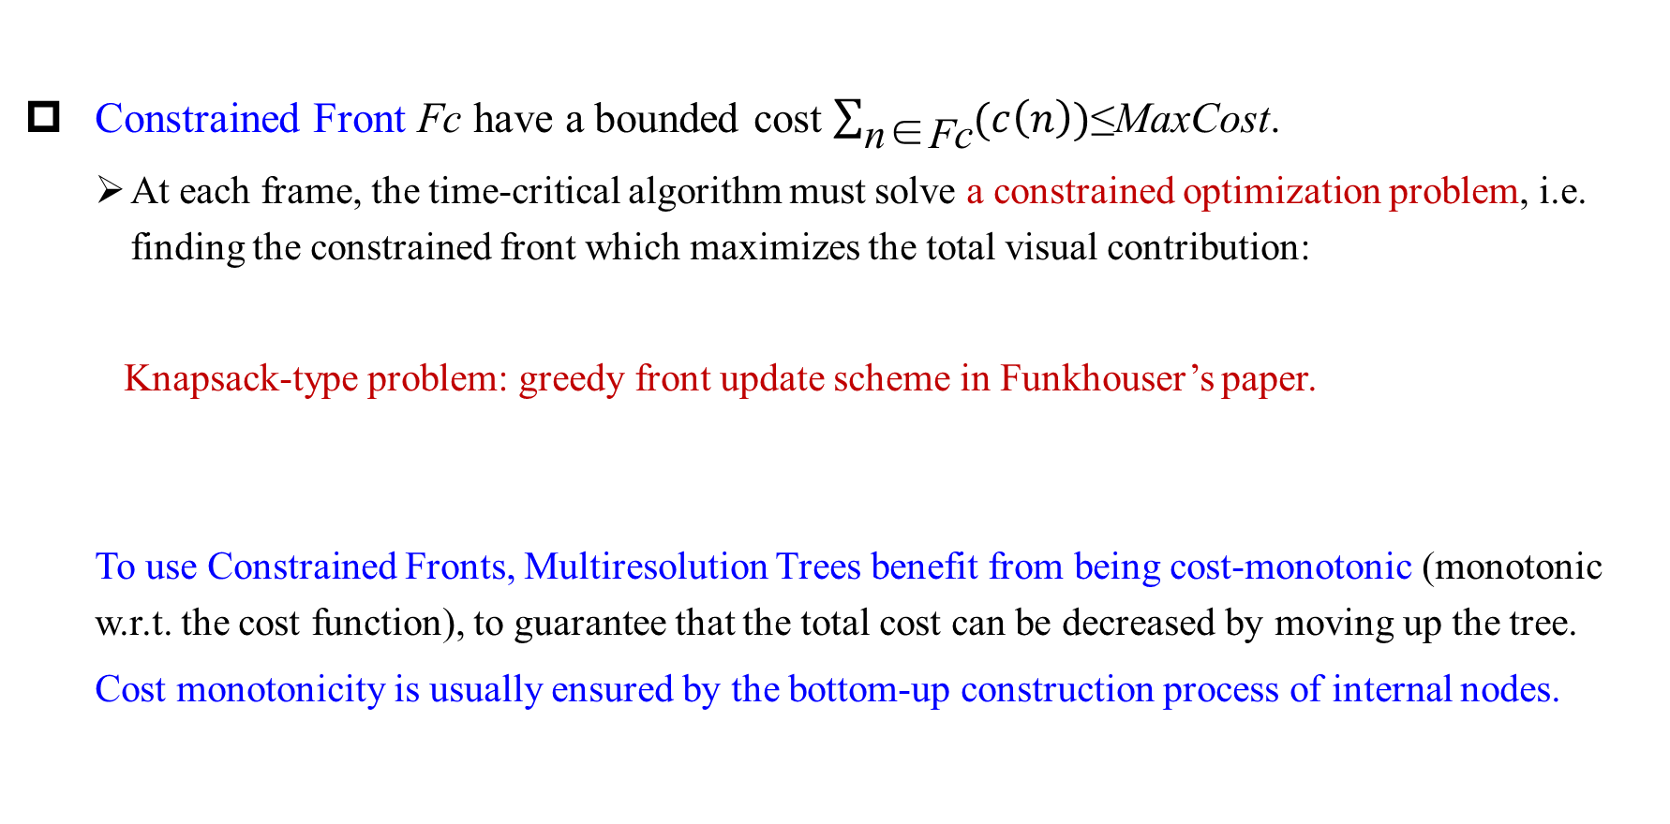
Constrained Front
Constrained Front Fc have a bounded cost $\sum_{\text{n}\text{∈}\text{Fc}}{(c\left(n\right))\text{≤}\text{MaxCost}}$.
At each frame, the time-critical algorithm must solve a constrained optimization problem, i.e. finding the constrained front which maximizes the total visual contribution:
Knapsack-type problem: greedy front update scheme in Funkhouser’s paper.
To use Constrained Fronts, Multiresolution Trees benefit from being cost-monotonic (monotonic w.r.t. the cost function), to guarantee that the total cost can be decreased by moving up the tree.
Cost monotonicity is usually ensured by the bottom-up construction process of internal nodes.
Notes:
为了能够使用带约束的前端，多分辨率树benefit必须是代价单调的。

Slide 16
Constrained Front properties
Property 1. Visual-Contribution Fronts can guarantee a certain image quality, but cannot guarantee a given frame rate. Constrained Fronts, on the contrary, can guarantee a frame-rate, but at a variable image quality.
Property 2. Constrained fronts Fc must be computed by updating the front of the previous frame. They cannot be obtained by a top-down tree traversal. They rely on lazy updates and CPU-GPU transmission algorithm. At each frame, only a few updates are performed and sent to GPU.
Property 3. Confronted with drastic camera movements, an algorithm computing Fc will still comply with the frame-rate, but will need several frames to maximize the image quality.
Property 4. Time-critical rendering algorithms require specific data structures to manage visibility.
Notes:
2. 当相机突然移动，Fv计算与其他相同，自上而下，从根节点开始选择前端所需节点。对于Fc需要大量的前端更新操作，因此需要 懒更新.
3. Fc需要保存场景的完整表示，来执行增量更新，即使这些新节点不被遮挡或进入新视锥。

Slide 17
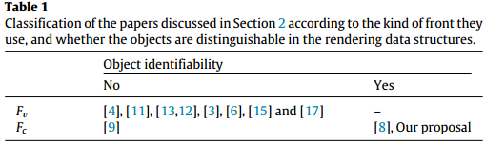
Constrained Front properties
Time-critical visualization with a rendering budget requires a monotonic Multiresolution Tree with respect to both c(n) and v(n, C), and should be based on a constrained front Fc, with local, incremental front updates at each frame, lazy transmission and updates, and visibility management.

Slide 18
Outline
1. Introduction
2. Previous work
3. View-dependent, front-based rendering
4. Hybrid multiresolution trees (HMTs)
5. Visualization and interactive scene editing
6. Results & Conclusions and future work

Slide 19
Hybrid multiresolution trees (HMTs)
Hybrid Multiresolution Kd-tree contains three different layers of nodes and associated object data.
Exact-layer: Exact geometry of objects.
SP-layer: simplified polygonal representation of the portion of the scene.
RI-layer: the most aggressive simplifications of their subtrees.
Setting in Top three or four levels
Represented as ORIs (image-based representation).
HMTs object-aware: HMTs can support selection of objects and groups of objects by clicking anytime on any of their triangles
Notes:
在多分辨率树的前三层或四层设置RI-layer可以取得帧速率和图像质量的很好的平衡。
采用image-representation的ORIs来表示RI-layer，对于包含复杂几何的节点可以呈现较好的帧速率和图像质量。

Slide 20
Hybrid multiresolution trees (HMTs)
The algorithm to render HMTs implements a constrained front to address the requirement of a guaranteed frame-rate. The cost c(n) and visual contribution v(n, C) for tree node n satisfy these monotonicity properties:
For any non-leaf node in the tree, its cost is lower than the sum of the costs of its direct children.
For any non-leaf node in the tree, its visual contribution is lower than the sum of the visual contributions of its direct children, regardless of the camera location.
This paper generalize Funkhouser’s algorithm to render the HMT data structure, and try to (suboptimally) solve a constrained optimization problem at each frame.
Notes:
证明cost和visual contribution都是单调的，HMTs是单调的可以支持约束前端Fc，可以通过求解带约束的次优问题实现时间关键的渲染。

Slide 21
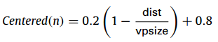
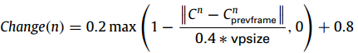
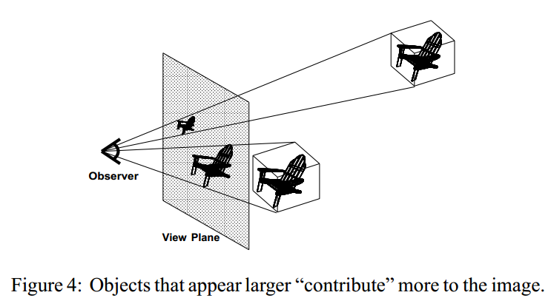
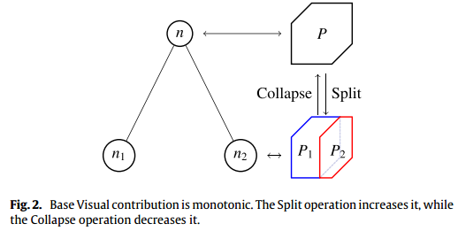
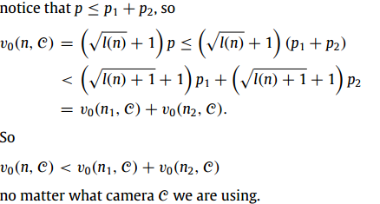
Hybrid multiresolution trees (HMTs)
The cost is static, and is computed for each node during the tree generation.
The visual contribution of a certain node is a function which estimates its contribution to the overall perceived image quality. It is dynamic, depending on some intrinsic node information and on the camera parameters during the navigation.
Notes:
当节点n被投影并保持在视口中心的时候，v0(n, C) 是关于其投影大小p(n, C) 和在树中级别l(n)的函数，它测量节点对于图像的整体视觉质量的贡献。
投影尺寸p(n, C) 指的是n的轴对齐包围盒AABB(n)在屏幕投影的表面面积（以像素为单位）。v0(n, C) 表示当节点有比较大的投影大小的时候，它对最终结果的视觉贡献更大。Quality(k) 导致单调的视觉贡献。
其余三个参数通过考虑相机参数以及其随时间变化来修改v0(n, C) ，通过实验设置的参数控制。
前两个参数，将他们的最大影响减少20%可以达到很好的效果，如果给予更大的强度，可能导致过度地降低节点贡献值，从而进一步引起比真正必要的更大的简化，最终增加伪像的数量。如果影响定义较小，结果是快速移动的节点或者在视口边界附近的节点过于详细，导致成本增加。由于我们运行在有限的预算，可能降低其他地方的质量。
Vpsize 视口对角线的一半，dist从视口中心到AABB(n)到视口投影的距离，第一个参数试图捕获视口周边的视觉敏锐性。第二个参数是递减函数，测量节点的投影位置的变化率。其主要思想是当对象明显运动时，我们具有降低的视敏度。C n 指节点包围盒的投影中心。第三个参数考虑了遮挡。为了效率问题，使用来自上一帧遮挡查询的信息。
如何证明视觉贡献是单调的，基本贡献单调，其他参数影响不大，动态视觉贡献是单调的， 成本cost在构建过程中就是单调的。

Slide 22
Generation of the HMT
Objects in the input files are assigned sequential integer labels, and a single triangle soup is created and stored in external memory.
Creation of Kd-tree structure->standard recursive space splitting algorithm. Subdivision is repeated until nodes contain less than 50K triangles each.
Node in the SP-layer are computed by bottom-up simplification, starting by the parents of the already defined Exact-layer nodes->Simplification scheme uses volumetric technique with surface construction.
Upper tree layer (RI-layer) is computed with an modified algorithm based on ORIs.
Notes:
Kd树创建原则，划分后兄弟节点三角形个数大致相同，kd树创建后，所有叶子节点包含它们最终的几何。
SP-layer自下而上的简化
RI-layer

Slide 23
SP-layer node generation
Visibility culling.
Complexity test. If the node has less than 50K triangles?
Node voxelization. Nv=200
Surface simplification.
Clipping. The resulting geometry is clipped inside the box of the node.
Cost computation. The resulting number of polygons in the node (cost) is tested for monotonicity. If the cost is not lower than the sum of the children’s costs, Nv is decreased by a 10% and steps 3…6 are repeated.
Notes:
1.可见性剔除，节点用相邻叶子节点扩大一层，围绕其中心从320个方向渲染。没有出现在任何渲染中的三角形被标记为不可见。
2.复杂性检测，判断节点中三角形个数是否小于50k
3.节点体素化，每个节点的包围盒在所有方向扩大5%以避免节点之间的裂缝。最大方向体素个数200
4.表面简化，对于每一个体素v，分类v中初始模型的所有节点。体素的标签根据对象索引和他们法线向量的方向指定，三角形中两个或三个节点的标签相同就认为悬挂或删除。所有具有相同标签的顶点折叠到它们的质心，编程他们的代表节点。
5. 剪切，将包围盒内的节点剪切。
6. 成本计算。检验单调性，

Slide 24
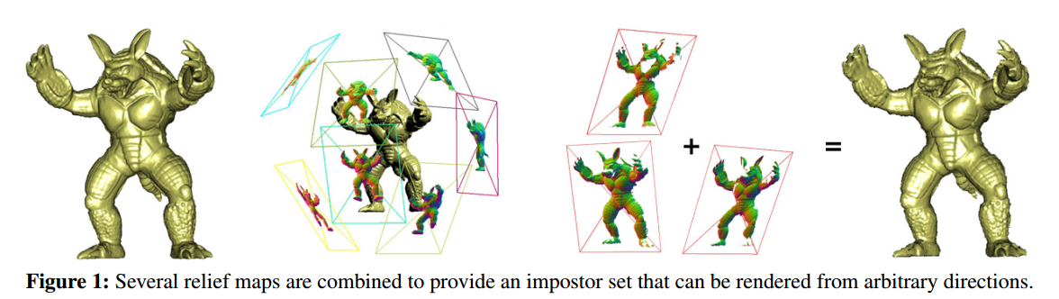
RI-layer node generation
The RI-layer fills levels 0…2 of the HMT, and each node is represented by 30 or less relief impostors.
Nodes in the RI-layer is assigned a constant cost (because of the uniform number of impostors per node). Cost monotonicity is therefore guaranteed by construction. The cost value is computed as an equivalent triangle count, based on the rendering time.
To make the HMT object-aware, we store for each triangle an integer identifier of the object it belongs to. In order to efficiently access material properties we store them in an N*N Object Texture.
Notes:
每个方向的替身节点存储颜色、深度和法向信息，相邻节点也被渲染来完善替身信息。
如何区分不同对象，对每个三角形根据所属对象分配一个整数标识符。

Slide 25
Outline
1. Introduction
2. Previous work
3. View-dependent, front-based rendering
4. Hybrid multiresolution trees (HMTs)
5. Visualization and interactive scene editing
6. Results & Conclusions and future work

Slide 26
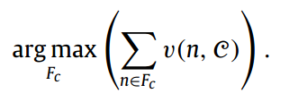
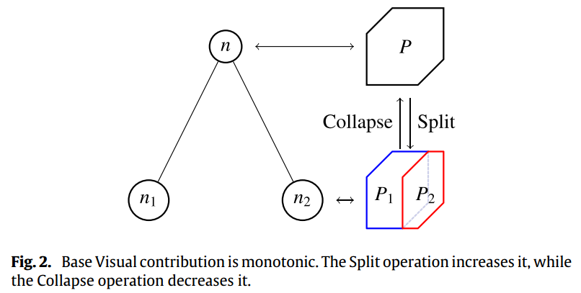
Visualization and interactive scene editing
The visualization algorithm is based on a dynamic constrained front Fk..
The rendering algorithm solves the constrained optimization problem.
The optimization starts with the front at the previous frame and updates it. Front update is based on two operations, node split and node collapse.
Front nodes:
Outside the present frustum
Occluded nodes
Visible nodes
Invisible nodes
Notes:
可视化算法基于动态约束前端，前端Fk是第k帧需要渲染的HMT节点列表以及包围盒中心的设备坐标，前端还包含在当前视锥之外的上层树表示的区域，来支持当相机快速移动时的有效更新。
前端结构是基于CPU的，但是当需要时，前端节点以Vertex Buffer Objects形式缓存在GPU中。

Slide 27
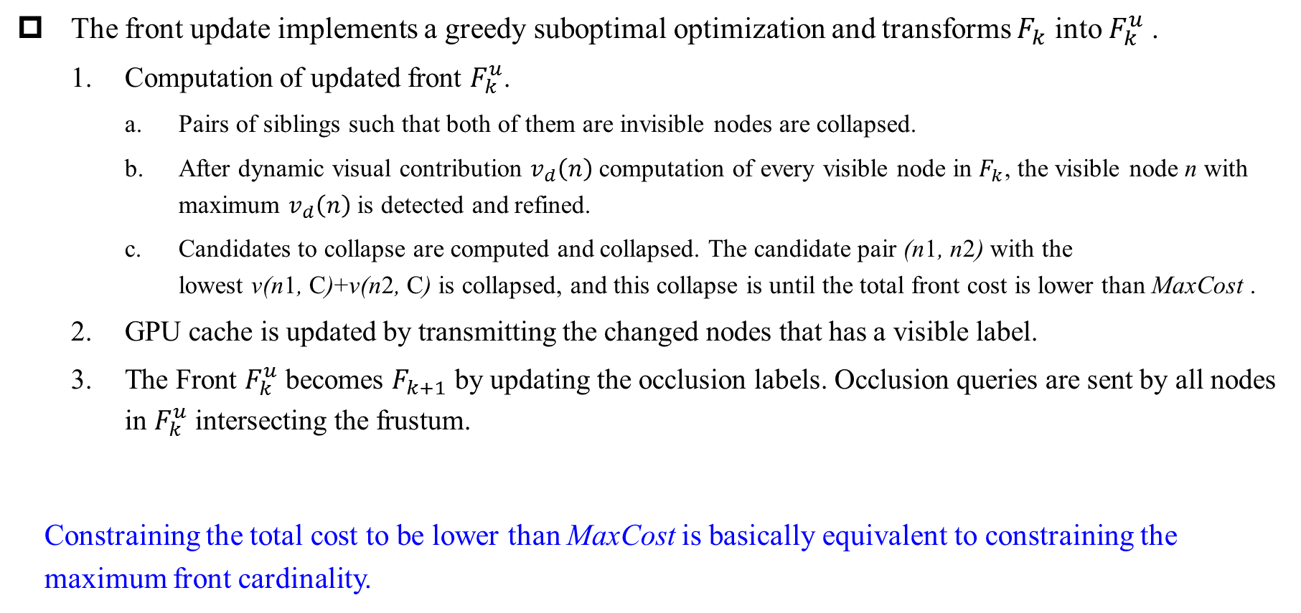
Visualization and interactive scene editing
The front update implements a greedy suboptimal optimization and transforms $F_{k}$ into $F_{k}^{u}$ .
Computation of updated front $F_{k}^{u}$.
Pairs of siblings such that both of them are invisible nodes are collapsed.
After dynamic visual contribution $v_{d}\left(n\right)$ computation of every visible node in $F_{k}$, the visible node n with maximum $v_{d}\left(n\right)$ is detected and refined.
Candidates to collapse are computed and collapsed. The candidate pair (n1, n2) with the lowest v(n1, C)+v(n2, C) is collapsed, and this collapse is until the total front cost is lower than MaxCost .
GPU cache is updated by transmitting the changed nodes that has a visible label.
The Front $F_{k}^{u}$ becomes $F_{k+1}$ by updating the occlusion labels. Occlusion queries are sent by all nodes in $F_{k}^{u}$ intersecting the frustum.
Constraining the total cost to be lower than MaxCost is basically equivalent to constraining the maximum front cardinality.
Notes:
3.计算折叠候选项并折叠。折叠候选项是Fk中的一对兄弟节点，其中至少一个是可见的。

Slide 28
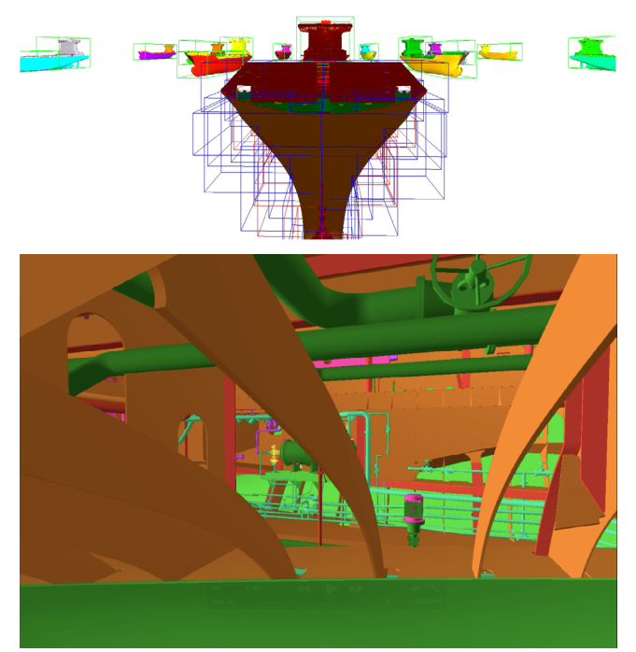
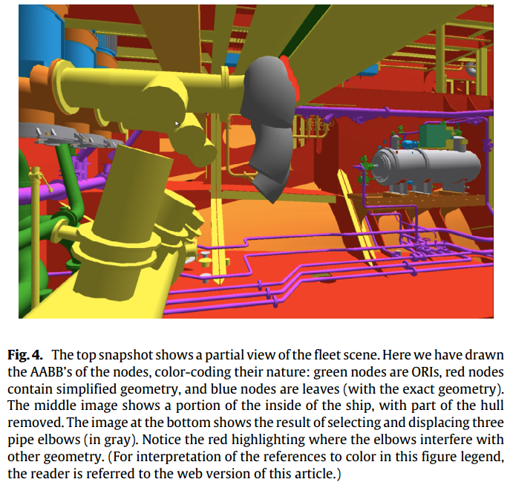
Interactive scene editing
Operations on sets of selected objects-optionally selected directly in the CAD design tree–use the Object Texture. Selection feedback is performed via a changed of the object material color.
Interactive dragging of the set of selected objects is possible, in sets of moderate cardinality.
Unique global indices allow to log also other sorts of user annotations or modifications to the selected objects.
Approximate collision detection is supported during the edition and dragging of the selected objects in a hierarchical way.
Notes:
3.计算折叠候选项并折叠。折叠候选项是Fk中的一对兄弟节点，其中至少一个是可见的。

Slide 29
Outline
1. Introduction
2. Previous work
3. View-dependent, front-based rendering
4. Hybrid multiresolution trees (HMTs)
5. Visualization and interactive scene editing
6. Results & Conclusions and future work

Slide 30
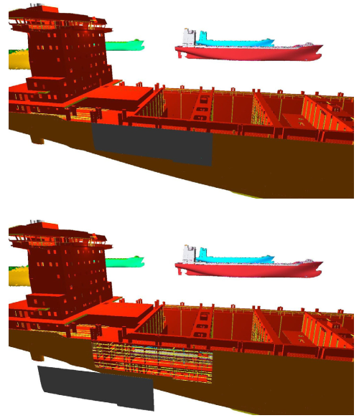
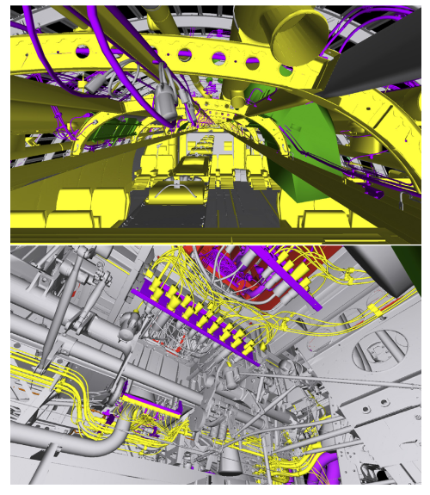
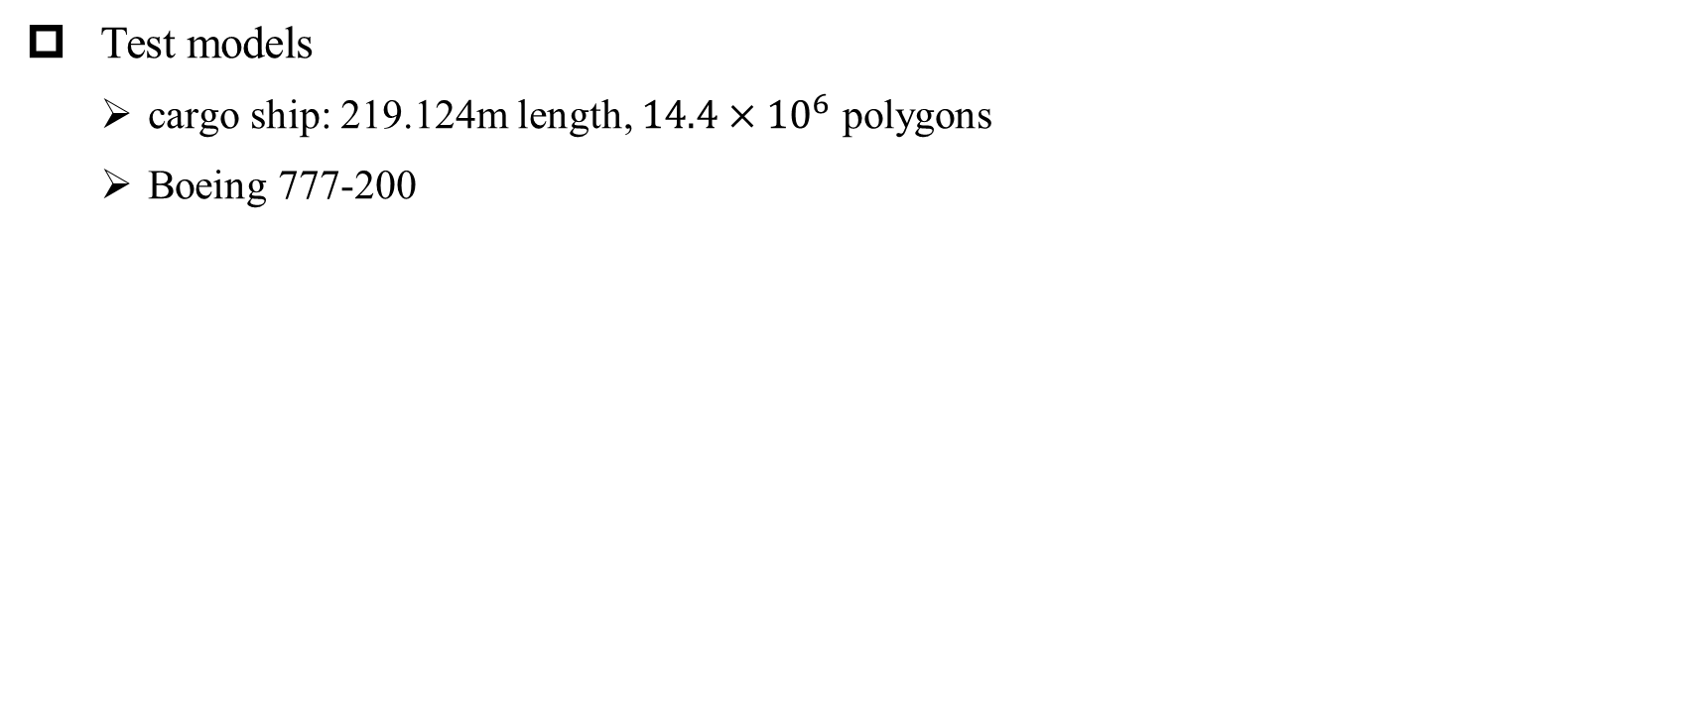
Results
Test models
cargo ship: 219.124m length, $14.4×{10}^{6}$ polygons
Boeing 777-200

Slide 31
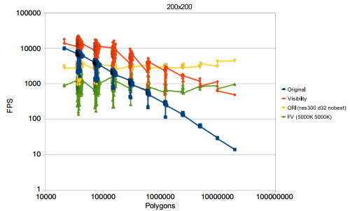
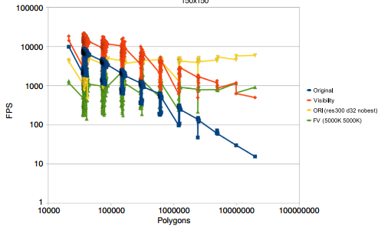
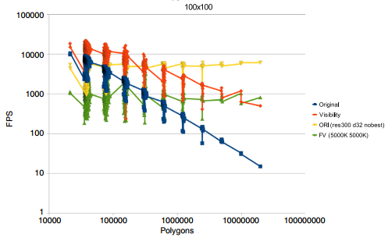
Results: User-perceived visual quality in ORIs and far voxels
Test the visualization of complex scenes with many differentiated objects.
Rendering efficiency
3 tests with viewport sizes of 100*100, 150*150 and 200*200 pixels.
4 cases (Original, Visibility, ORI, FV)
Fig. 6. Comparative speeds in different rendering techniques for large datasets in a 200×200 viewport (top), a 150×150 viewport (middle) and a 100×100 viewport. The test was run on a machine with a 4-core Intel i7 at 3.2 Ghz, with 12 Mb of memory and a GeForce GTX570 graphics card with 1.25 Gb of DDR5 memory, using Windows 7 Professional 64bits.

Slide 32
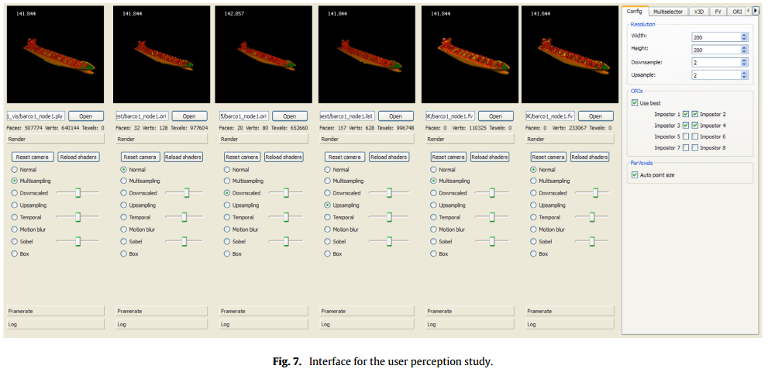
Results: User-perceived visual quality in ORIs and far voxels
Test the visualization of complex scenes with many differentiated objects.
Visual Quality: Visualize a chosen tree node simultaneously in six viewports each one having 200*200 pixels.
1. Nodes containing polygonal representations have a better performance when their cardinality is well below 1M polygons.
2. Image-based representations (specially, ORIs) are well behaved in nodes with extremely complex geometry, presenting a better and a good perceptual visual quality.
Notes:
第一个基于多边形 接着三个 ORI渲染算法。第五个是第一个视口中参考模型的重复，第六个FV方法

Slide 33
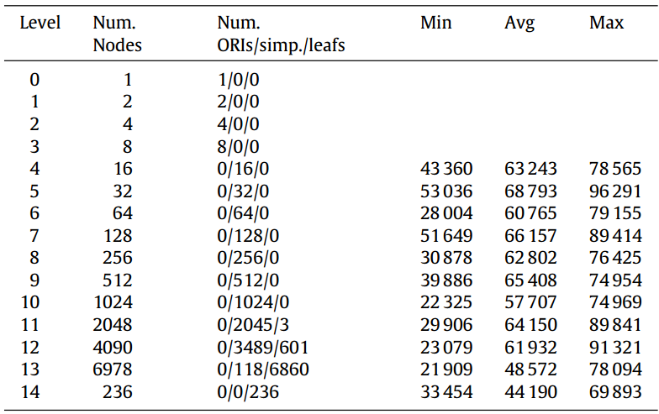
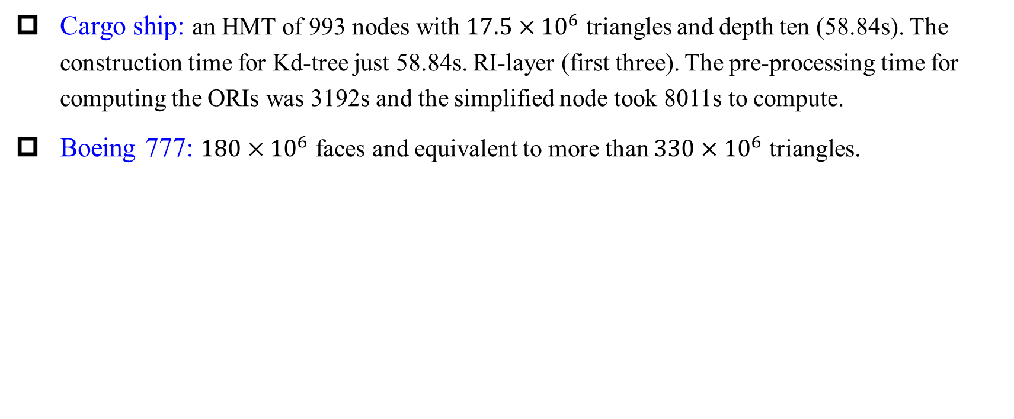
Results analysis and discussion
Cargo ship: an HMT of 993 nodes with $17.5×{10}^{6}$ triangles and depth ten (58.84s). The construction time for Kd-tree just 58.84s. RI-layer (first three). The pre-processing time for computing the ORIs was 3192s and the simplified node took 8011s to compute.
Boeing 777: $180×{10}^{6}$ faces and equivalent to more than $330×{10}^{6}$ triangles.
Notes:
最后三列是该层节点的最小、平均和最大三角形个数。

Slide 34
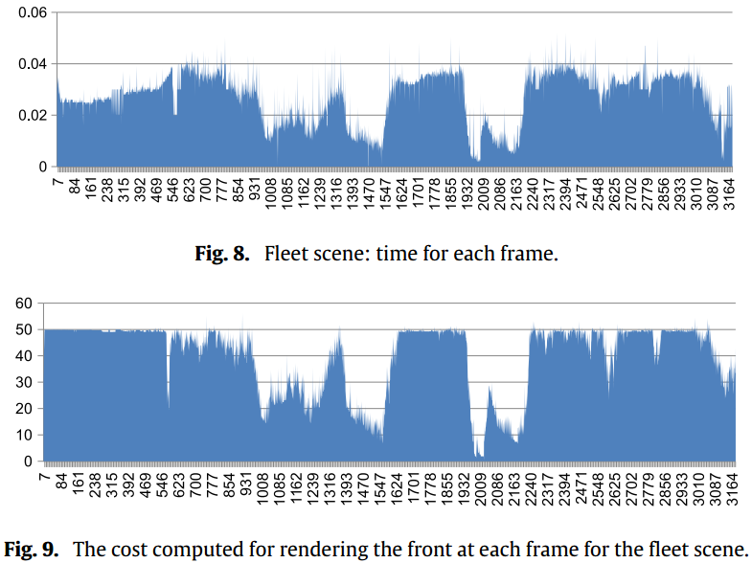
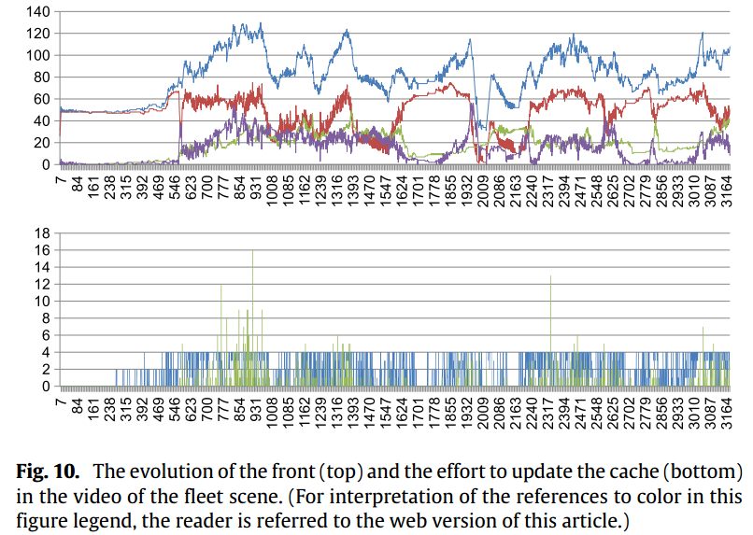
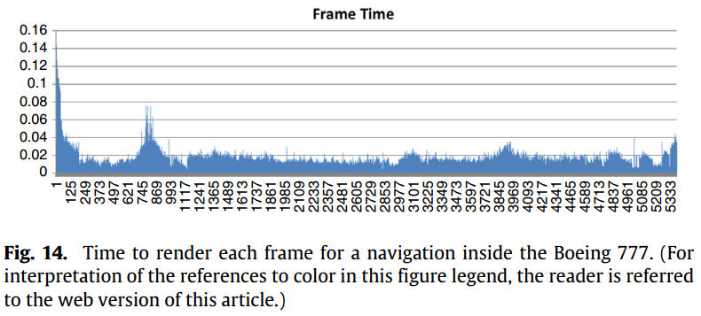
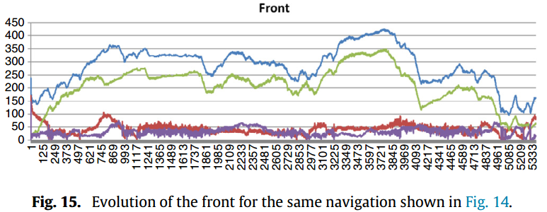
Results analysis and discussion
Notes:
图8 是船的每帧所需渲染时间，图9渲染前端所需计算成本，图10是每一帧中前端的大小，即节点个数。蓝色总节点 红色可见 绿色被视锥剔除的节点 蓝色呗遮挡测试梯度的节点，总节点个数一般小于120，下图指的是每帧中GPU缓存中跟新的节点个数。蓝色是由于split or collapse上传的节点 绿色是由于可见性下载的节点，比较独立的急剧变化是因为可见性突然变化。
图14 是 飞机每帧所需渲染时间 图15是飞机每帧前端大小。

Slide 35
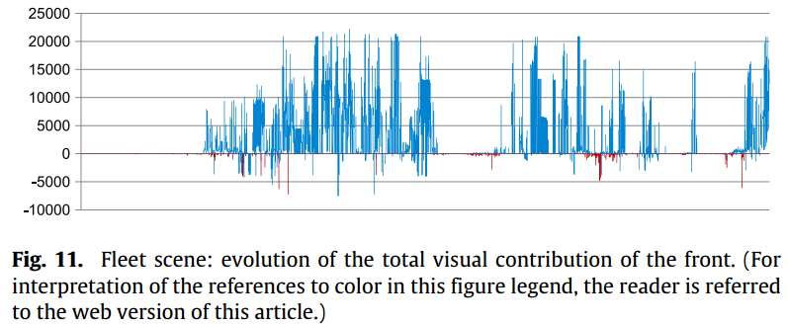
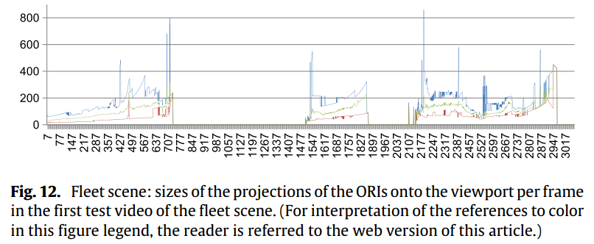
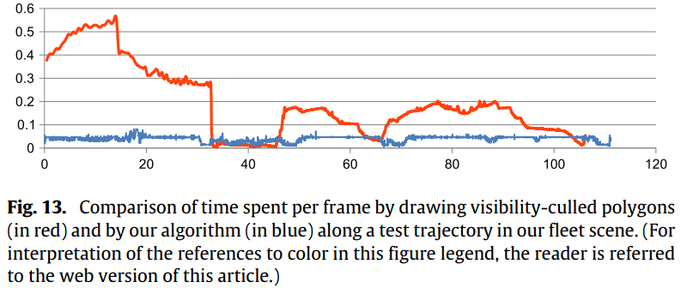
Results analysis and discussion
Notes:
图11 蓝色由于split增加的视觉贡献，红色由于collapse减少的视觉贡献。增加占主导地位。
图12 每帧中出现的RI-layer中节点的最大 蓝色 最小 红色和平均 绿色 节点大小。
图13 两个不同算法沿着舰队测试场景的不同轨迹所需绘制时间。

Slide 36
Conclusions and future work
The paper contributes to the field by proposing a formalization of the front concept and a new object-aware algorithm for the interactive inspection of huge models which uses a rendering budget and supports selection of individual objects and sets of objects, displacement of the selected objects and real-time collision detection during these displacements.
The implementation supports textured polygons and selection through attributes, but ORIs need to be further improved to handle them.
The approach would scale well for even larger models and modest hardware as the locality in space afforded by the Kd-trees, the whole pre-processing is amenable to being done out-of-core.
The out-of-core approach can be implemented in a fully automatic way.

